Slide 1
Documentation Generation:
Final Report
CSCI 2340
Dev Bhatia <dev_bhatia@brown.edu>, Abubakarr Jaye <abubakarr_jaye@brown.edu>, Riley Li <qiwen_li@brown.edu>, Sudham Hebbar <sudham_hebbar@brown.edu>, Yanan Song <yanan_song@brown.edu>, Yixin Deng <yixin_deng@brown.edu>, Yueqi Mao <yueqi_mao@brown.edu>, Helen Du <zhonghui_du@brown.edu>

Slide 2
Project Overview

Slide 3
Problem Statement
Documentation is difficult to write and keep up to date.
The goal of this project is to provide developers a more reasonable initial set of documentation using LLMs and other tools.

Slide 4
Requirements
The app should support various input sources, including source code files, comments, and documentation tags within the code.
The app must be able to parse and generate documentation for multiple programming languages.
Users should be able to customize the documentation output by manually editing the output.
A real-time preview feature allowing users to see how the documentation will look before finalizing the generation.

Slide 5
Specifications
The initial implementation of our project will be a web app that, when provided with a github link, generates a confluence page describing what the app does based on classes/methods within.
The confluence pages shall follow the same file structure as the source code and shall have a one to one mapping.
The application shall utilize a Retrieval-Augmented Generation (RAG) backend to construct the documentation
The application shall integrate Github Actions such that a push to main in a hypothetical target repository would trigger a regeneration of the confluence page.

Slide 6
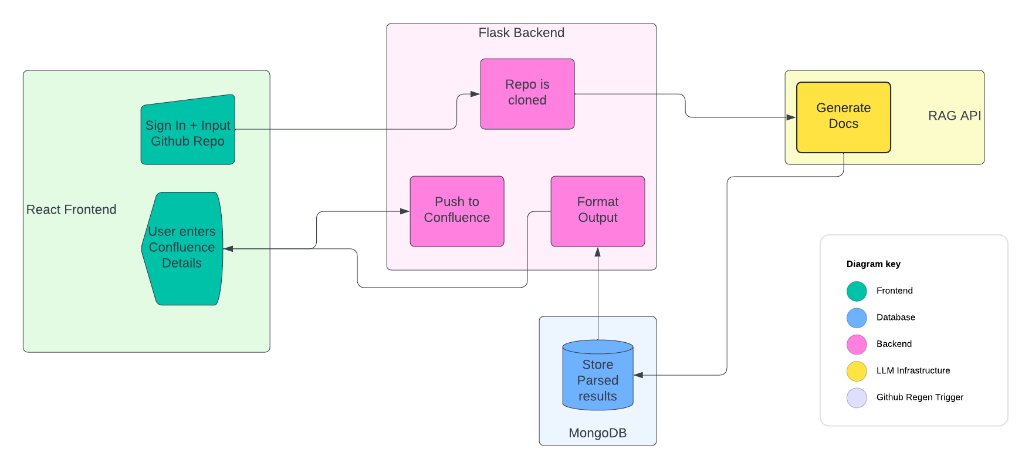
Current Architecture

Slide 7
Design Decisions

Slide 8
Frontend
Simple React Frontend
Framework/Library Used: Bootstrap, ReactTyped, useSpring …
Github OAuth
Github URL Input
Handles all user interaction

Slide 9
Backend
Flask Backend
Handles and cleans user input
Calls LLM generation function
Waits for and pulls results from database to push to confluence

Slide 10
LLM Integration
Azure GPT-4 Turbo LLM: We utilized the powerful GPT-4 Turbo LLM hosted on Azure.
Langchain: We utilized Langchain to process and analyze GitHub repositories.
AWS Services for URL Handling: We used AWS Simple Queue Service (SQS) and AWS Lambda for efficient handling of GitHub repository URLs.

Slide 11
Database
MongoDB Database
Data validation and modelling using pydantic
Mongo Change Streams
Status collection

Slide 12
UI/UX + Output

Slide 13
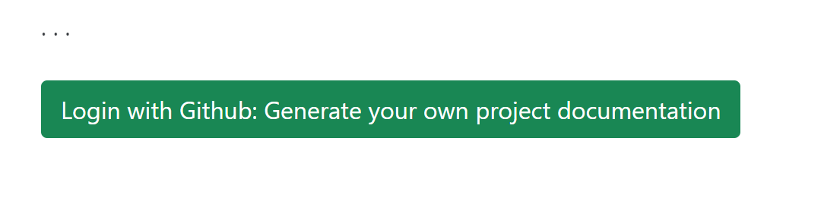
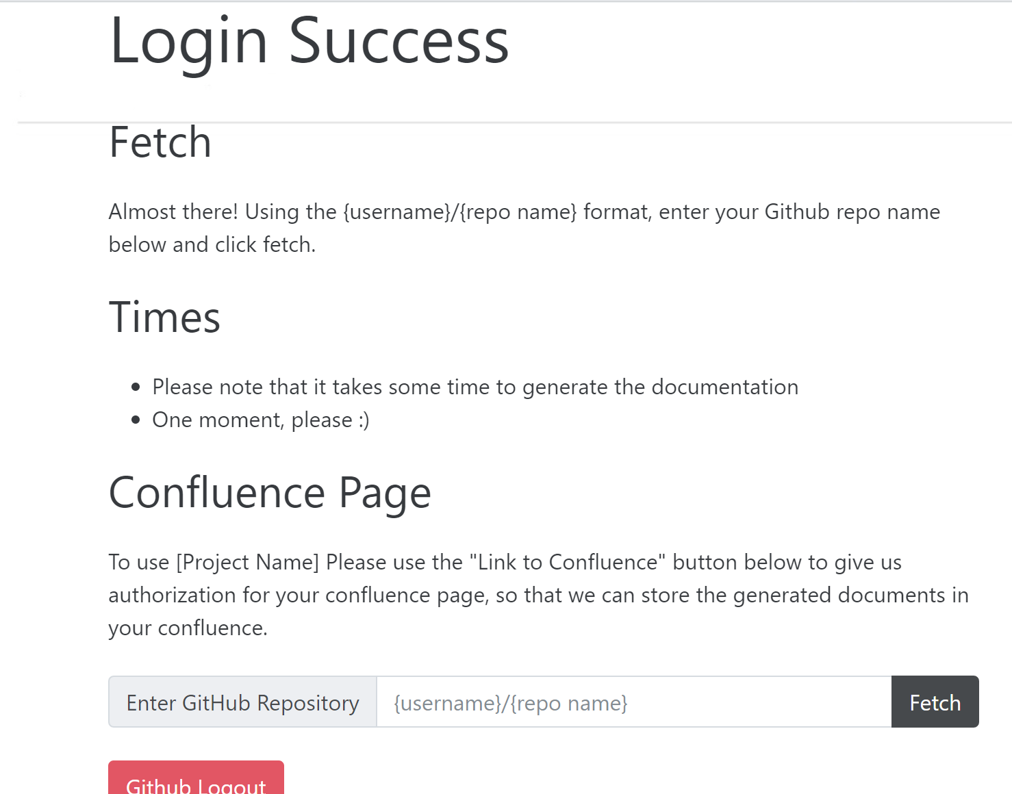
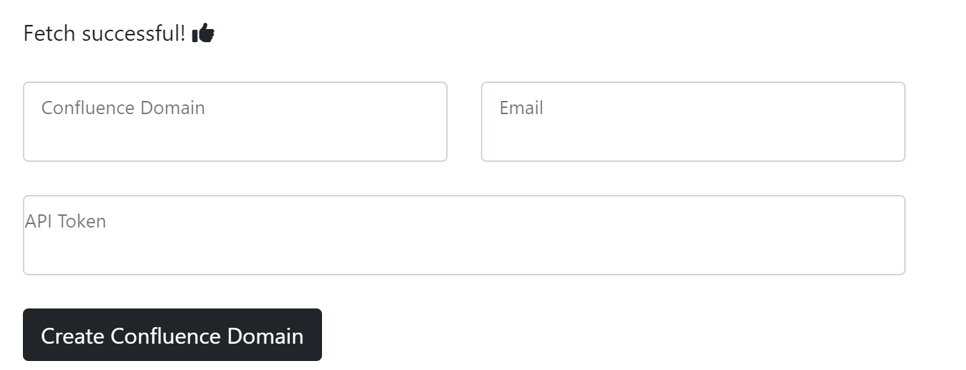

Slide 14


Slide 15
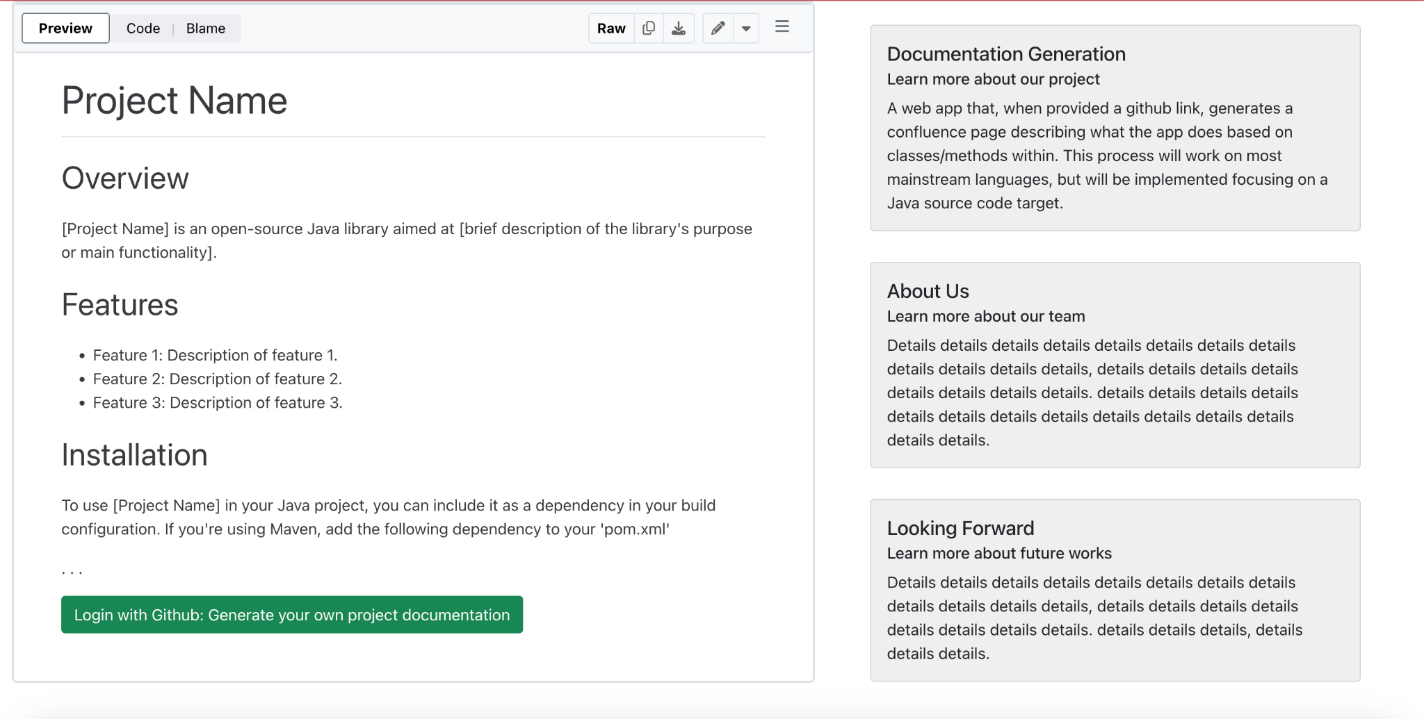
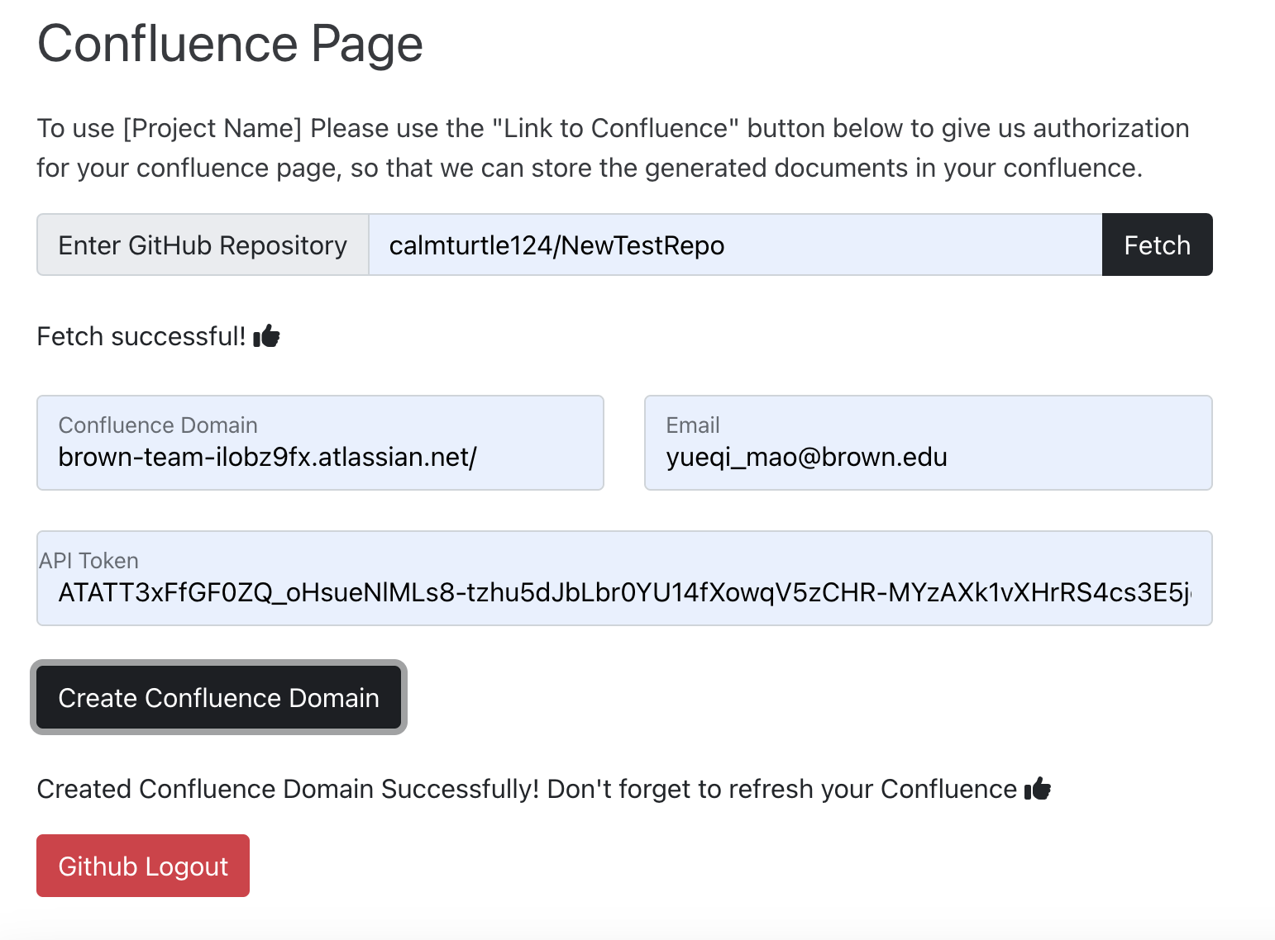
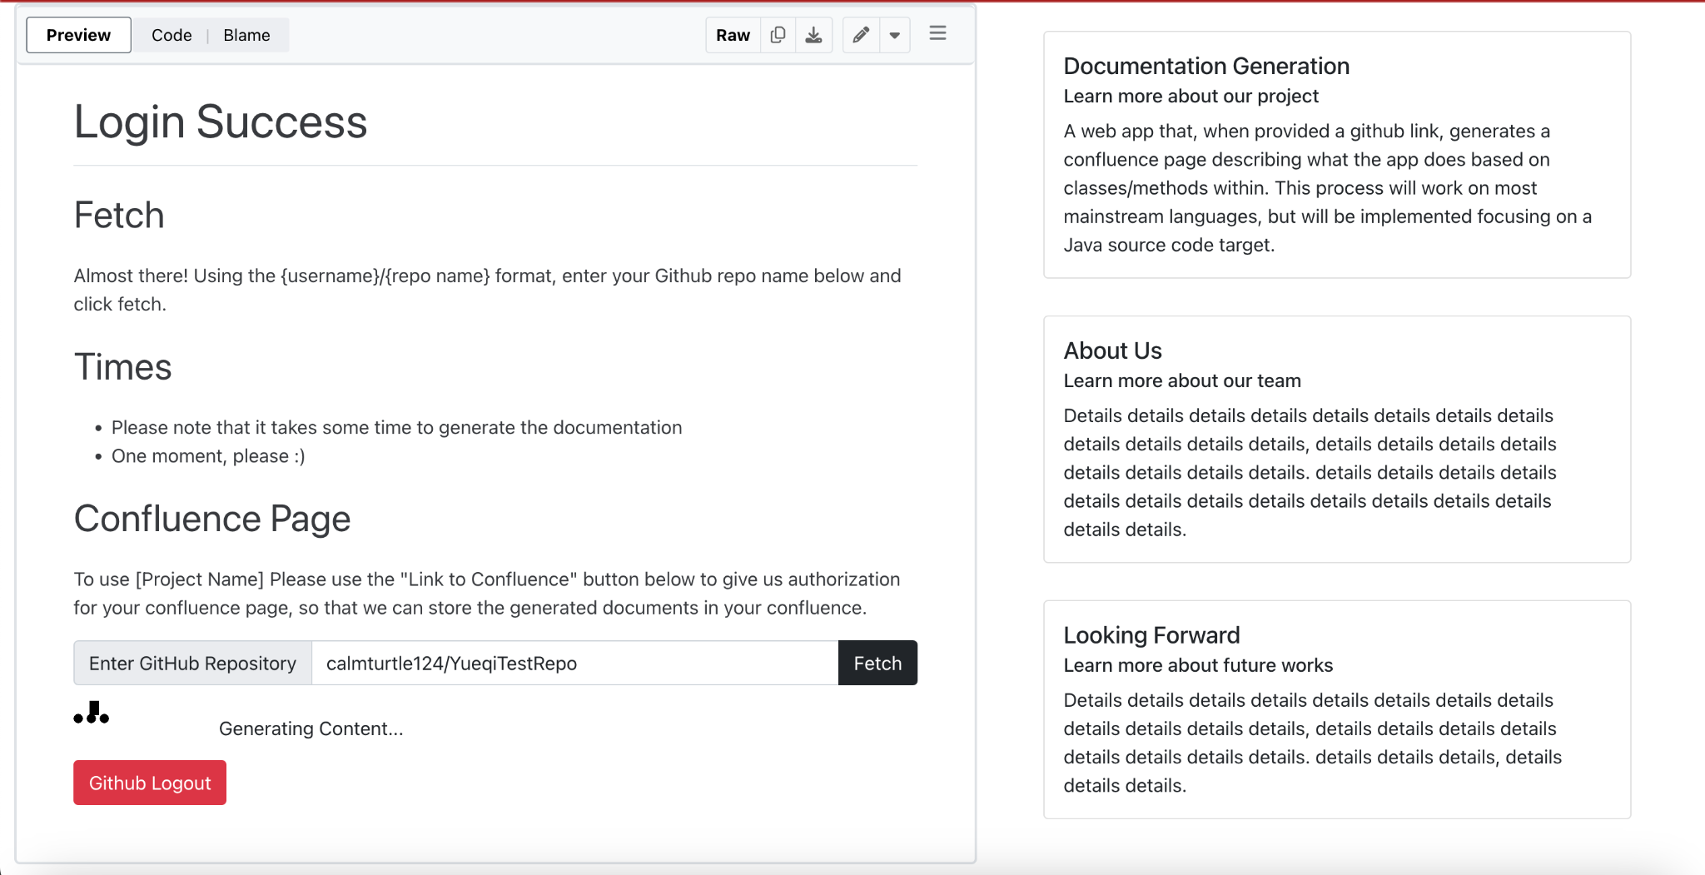

Slide 16
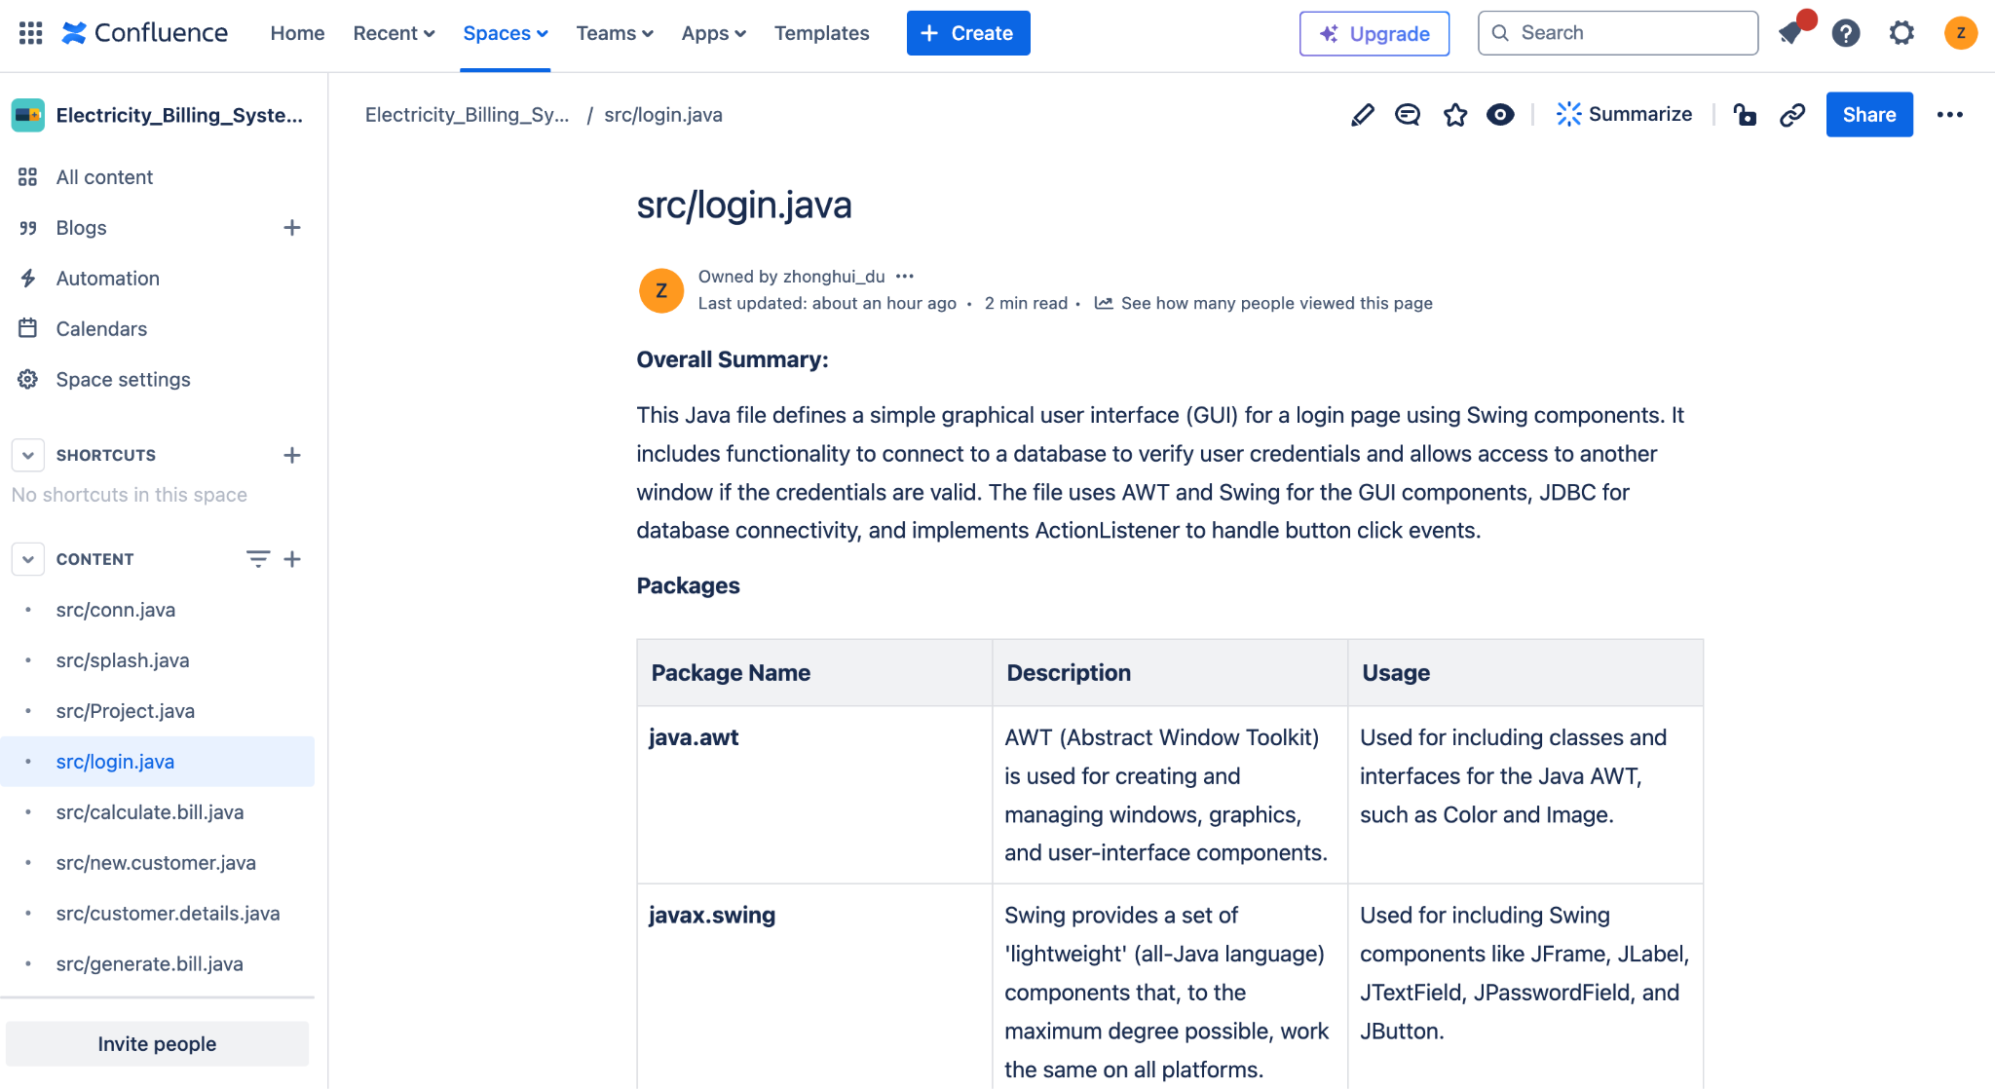

Slide 17
Implementation Strategy
First Pass
Second Pass
Third Pass
A simple frontend and backend that can talk to each other
Pulls README
Has github OAuth
Simple Error handling
Base for Developers to Build Concurrently
Preserve existing functionality
Add in LLM, database, and confluence capabilities
Base-level application complete
Fix Bugs
Improve performance
Expand functionality
Ready for user testing

Slide 18
Demo!

Slide 19
Final Steps

Slide 20
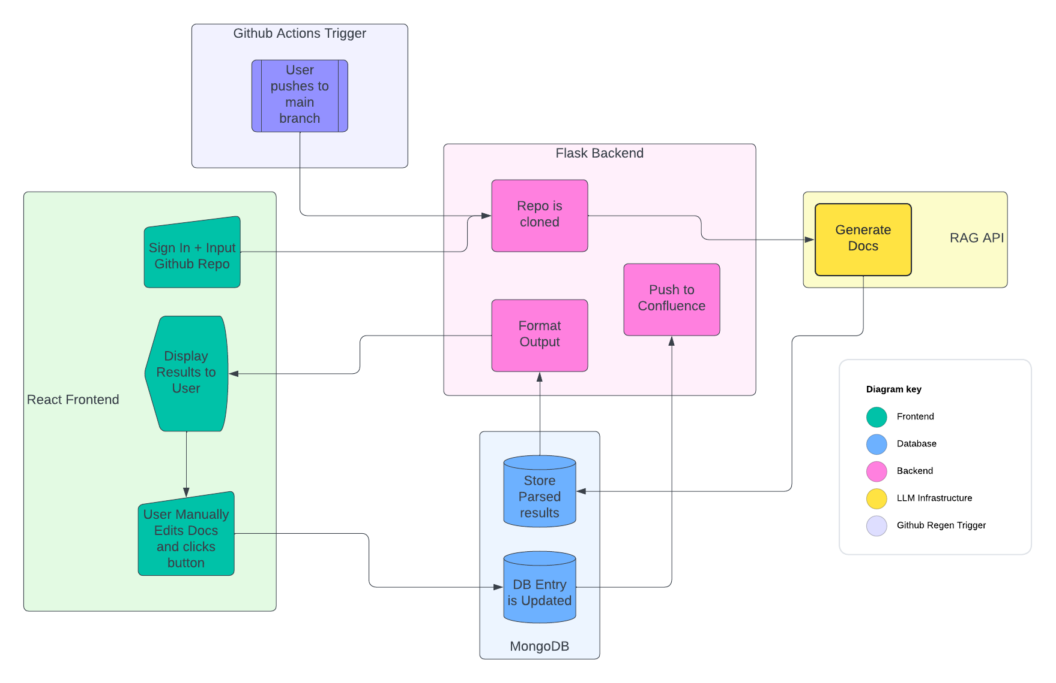
Final Planned Architecture

Slide 21
Things to Do
Bug Fixes
Integrate the Github Actions Trigger
Active PR currently!
Add intermediate step to allow for the user to edit the docs
Will require some cleaning on both sides to avoid breaking when pushing to the Confluence API
UI Tweaks
Status Messages
General Cleanup

Slide 22
Requirements
The app should support various input sources, including source code files, comments, and documentation tags within the code.
The app must be able to parse and generate documentation for multiple programming languages.
Users should be able to customize the documentation output by manually editing the output.
A real-time preview feature allowing users to see how the documentation will look before finalizing the generation.

Slide 23
Requirements
The app should support various input sources, including source code files, comments, and documentation tags within the code.
The app must be able to parse and generate documentation for multiple programming languages.
Users should be able to customize the documentation output by manually editing the output.
A real-time preview feature allowing users to see how the documentation will look before finalizing the generation.

Slide 24
Specifications
The initial implementation of our project will be a web app that, when provided with a github link, generates a confluence page describing what the app does based on classes/methods within.
The confluence pages shall follow the same file structure as the source code and shall have a one to one mapping.
The application shall utilize a Retrieval-Augmented Generation (RAG) backend to construct the documentation
The application shall integrate Webhooks and Github Actions such that a push to main in a hypothetical target repository would trigger a regeneration of the confluence page.

Slide 25
Specifications
The initial implementation of our project will be a web app that, when provided with a github link, generates a confluence page describing what the app does based on classes/methods within.
The confluence pages shall follow the same file structure as the source code and shall have a one to one mapping.
The application shall utilize a Retrieval-Augmented Generation (RAG) backend to construct the documentation
The application shall integrate Webhooks and Github Actions such that a push to main in a hypothetical target repository would trigger a regeneration of the confluence page.

Slide 26
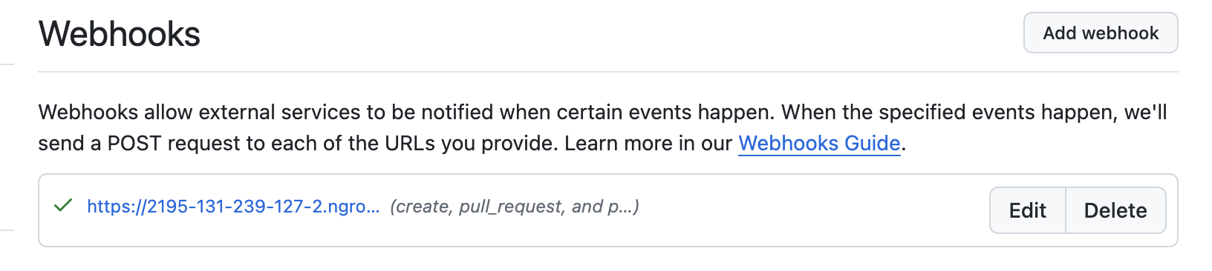
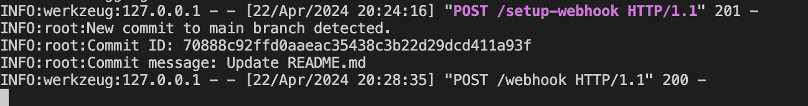
Specifications
The application shall integrate Webhooks and Github Actions such that a push to main in a hypothetical target repository would trigger a regeneration of the confluence page.

Slide 27
What We Learned
Setting up an initial infrastructure quickly was a good idea
Solid git workflows help the speed of development
Design choices should definitely be made after the requirements and specifications have been vetted
Concurrent development is great for speed, but leaves challenges in integration

Slide 28
Questions?

